Slide 1
Student performance
analysis
Data Science assessment for Andani

Slide 2
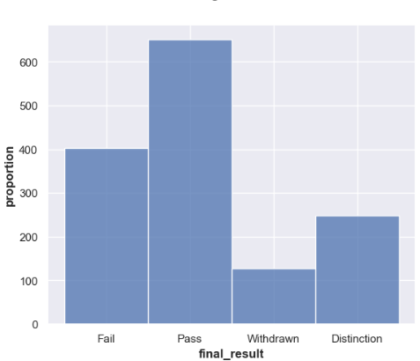
Student performance on the VLE
The visual indicates that a majority of students successfully pass, showcasing the effectiveness of current educational processes. However, the significant number of failures, coupled with the low number of distinctions and withdrawals, suggests opportunities for targeted interventions.

Slide 3
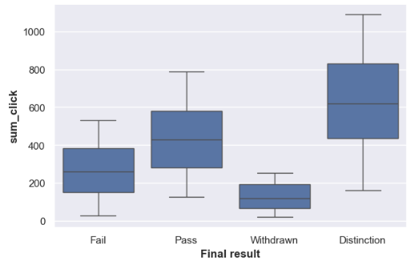
Student engagements Vs Performance
This visual shows that there exists a strong correlation between student engagement (clicks) in the Virtual learning environment and final results. Students with fewer clicks are more likely to fail or withdraw, while those with higher engagement tend to pass and achieve distinctions.

Slide 4
Key Findings
Higher engagement leads to better performance: Students who interact more with the Virtual Learning Environment (VLE) have higher chances of passing or achieving distinctions.
Assessment scores strongly predict final results: Students with high assessment percentages are more likely to succeed, while those with low scores are at risk of failing or withdrawing.
Consistent participation improves success rates: Students who engage with the VLE over multiple weeks perform better than those who disengage early.
Credit load does not determine success: The number of studied credits has no clear impact on final results; engagement and assessments matter more.
Retaking a course does not guarantee improvement: Students who attempt the course multiple times do not necessarily perform better, indicating the need for better support in reattempts.
Engagement is the strongest predictor of student success: The total number of clicks on course materials is the most influential factor in determining final outcomes.

Slide 5
Action Items
✅ Increase Student Engagement
Use interactive course materials like videos, and discussions to encourage participation.
✅ Identify and Support At-Risk Students Early
Track low-engagement students and provide targeted support through mentoring or academic counseling.
Offer additional learning resources or study sessions to struggling students.
✅ Monitor Assessment Performance and Intervene Quickly
Identify students with low assessment scores early and provide personalized feedback or tutoring.
✅ Promote Consistent Participation Throughout the Course
Break down course content into weekly milestones to maintain student engagement.
Provide incentives for regular participation to reduce dropout rates.

